Slide 1
Creating Our Own Microbial Fuel
Cell Ecosystem
By: Nora Elena, Jonathan, Jaleel, William

Slide 2
Table of contents
01
02
03
04
05
06
Goal & Motivation
Short Functionality
Short Specification
Detailed Functionality
Demo
Successes/Failures

Slide 3
01
Goal & Motivation
Notes:
Nora

Slide 4
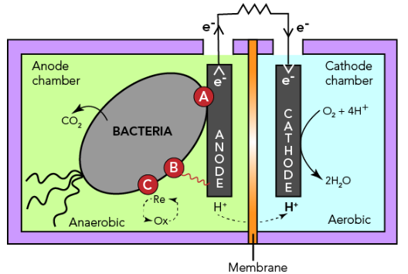
Goal & Motivation
Concrete Example
A wastewater engineer (Southampton Lab) designing a microbial fuel cell can adjust microbial interactions (e.g., cross-feeding or cooperation) and simulate whether the community produces stable electrical output before implementing it in a treatment system
Our objective is to translate real genetic circuits from sludge environments into a configurable simulation platform, allowing users to design ecosystems and assess their stability before implementation

Slide 5
02
Short Functionality
Notes:
Nora

Slide 6
Short Functionality
GUI
Six sliders let you adjust the influence of different biological circuit categories
System picks which modified strains belong in the community based on slider settings
Ecosystem simulation graph updates dynamically as parameters change
Simulates how the community behaves over time and displays it as a live graph
Purpose
Enables rapid exploration of how circuit combinations affect ecosystem behavior
Notes:
Nora

Slide 7
03
Short Specification
Notes:
Nora

Slide 8
Short Specification of circuits
Genetic circuits must be from sludge microbial environments
Circuits must map to defined interaction categories:
Auxotrophic cross-feeding
Metabolite production
Metabolite dependency
Cooperation
Each circuit must be representable using standardized components
promoter, RBS, CDS, terminator
The system must support modular selection and combination of multiple circuits
Design Requirements
Circuit selection limited to literature-supported sludge organisms
Biological interactions simplified into abstracted interaction models
Dependence on predefined categories
Limited parameter availability for accurate kinetic modeling
Simulation must remain computationally efficient for real-time use
Design Constraints
Notes:
Nora

Slide 9
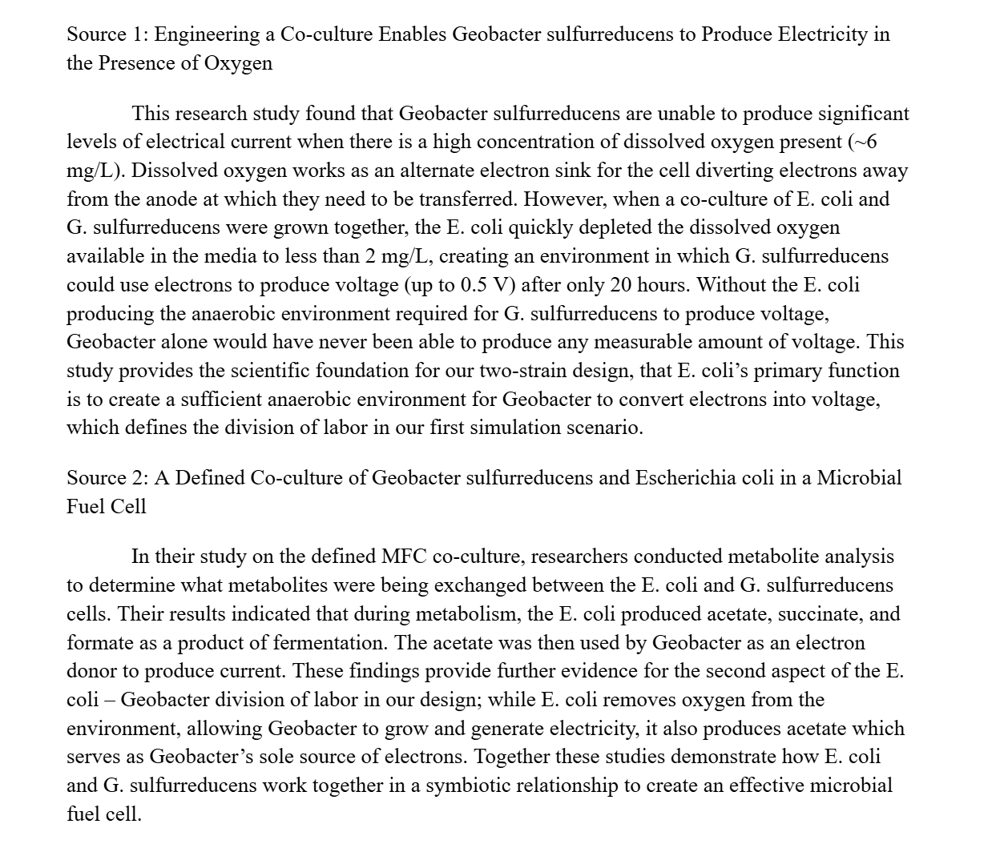
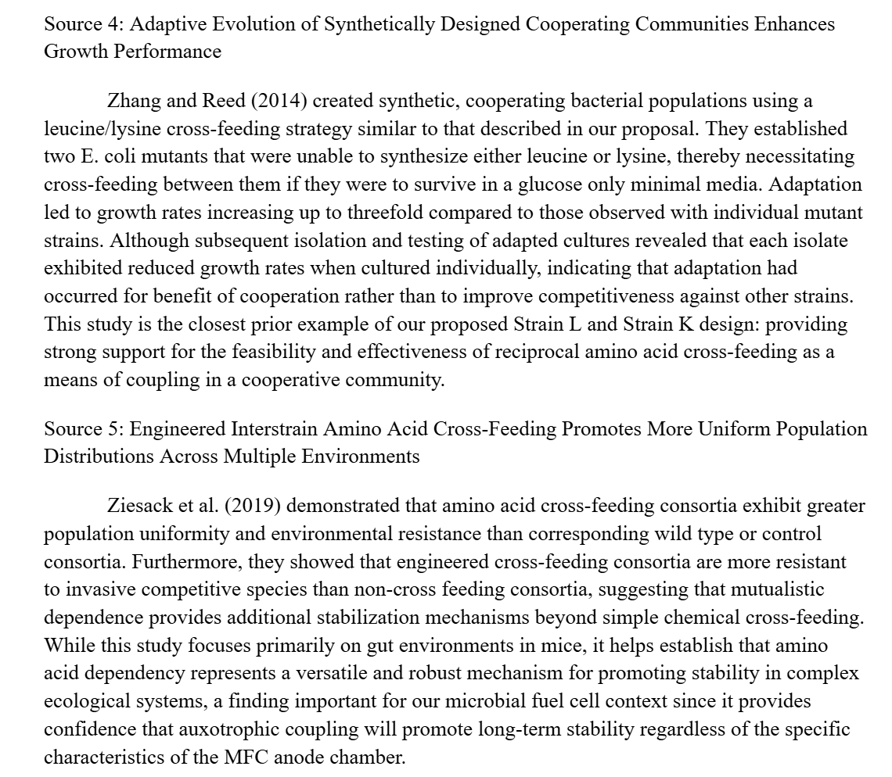
Literature Review that was used for Knox circuits
Notes:
Nora

Slide 10
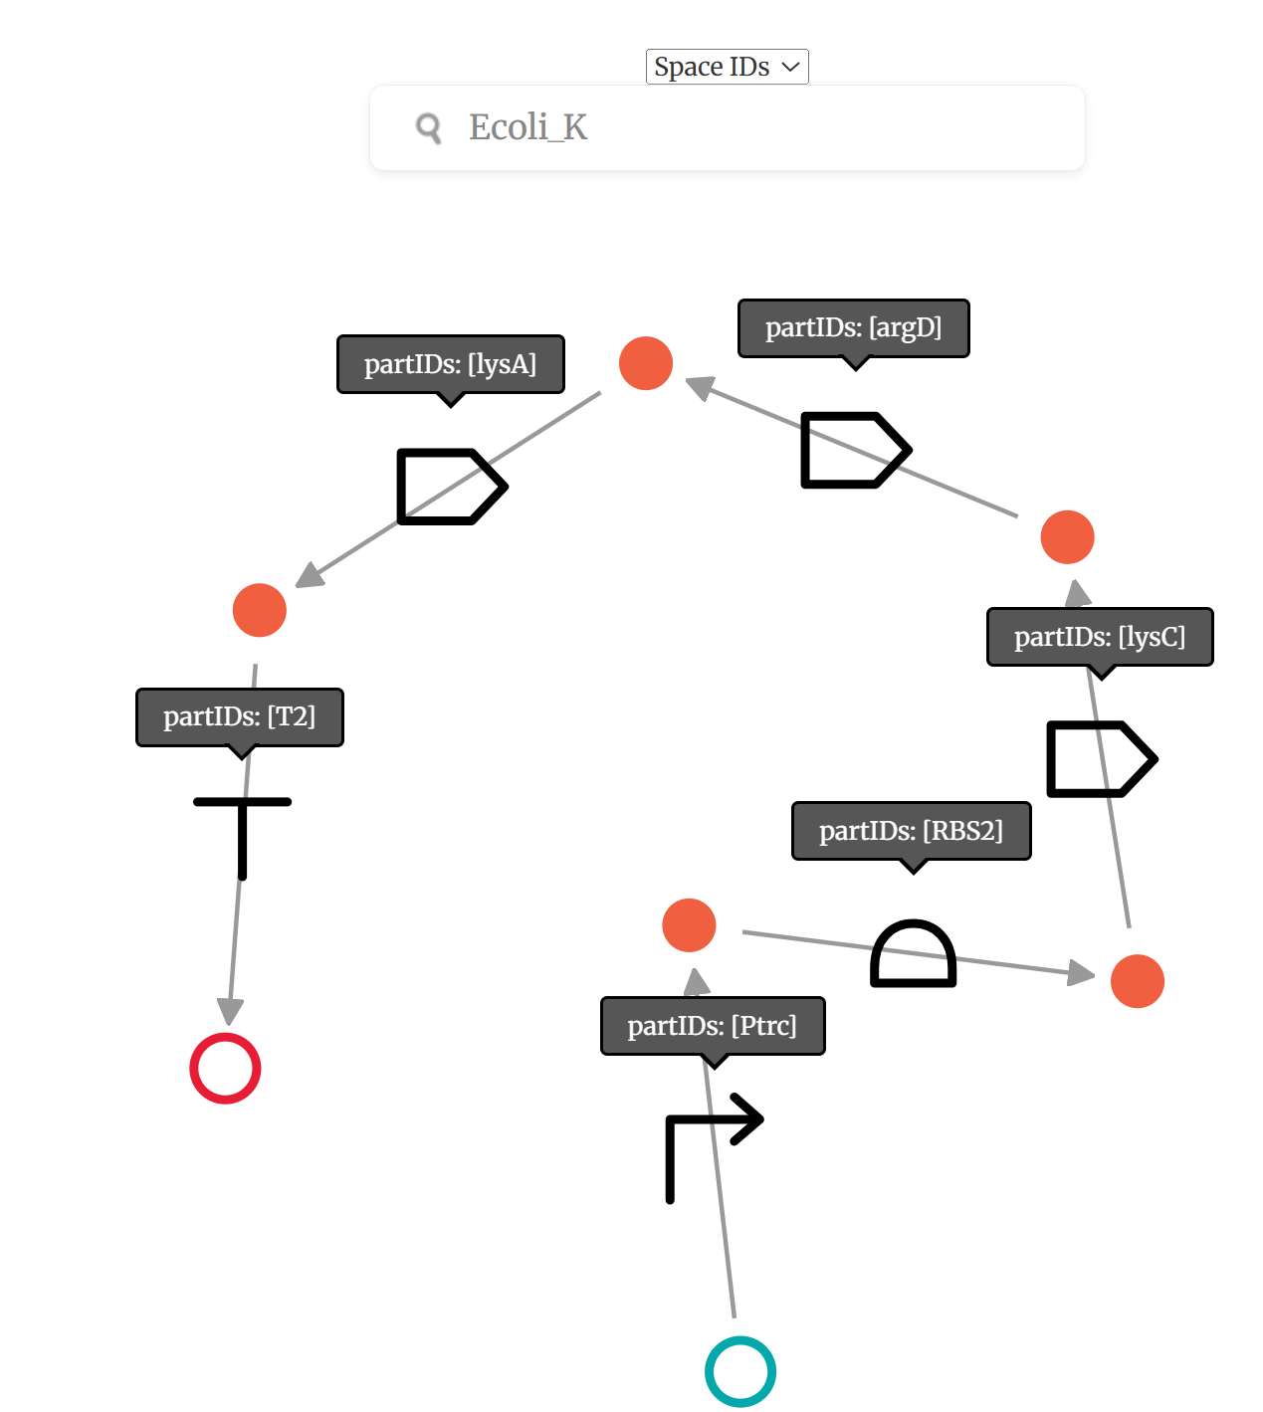
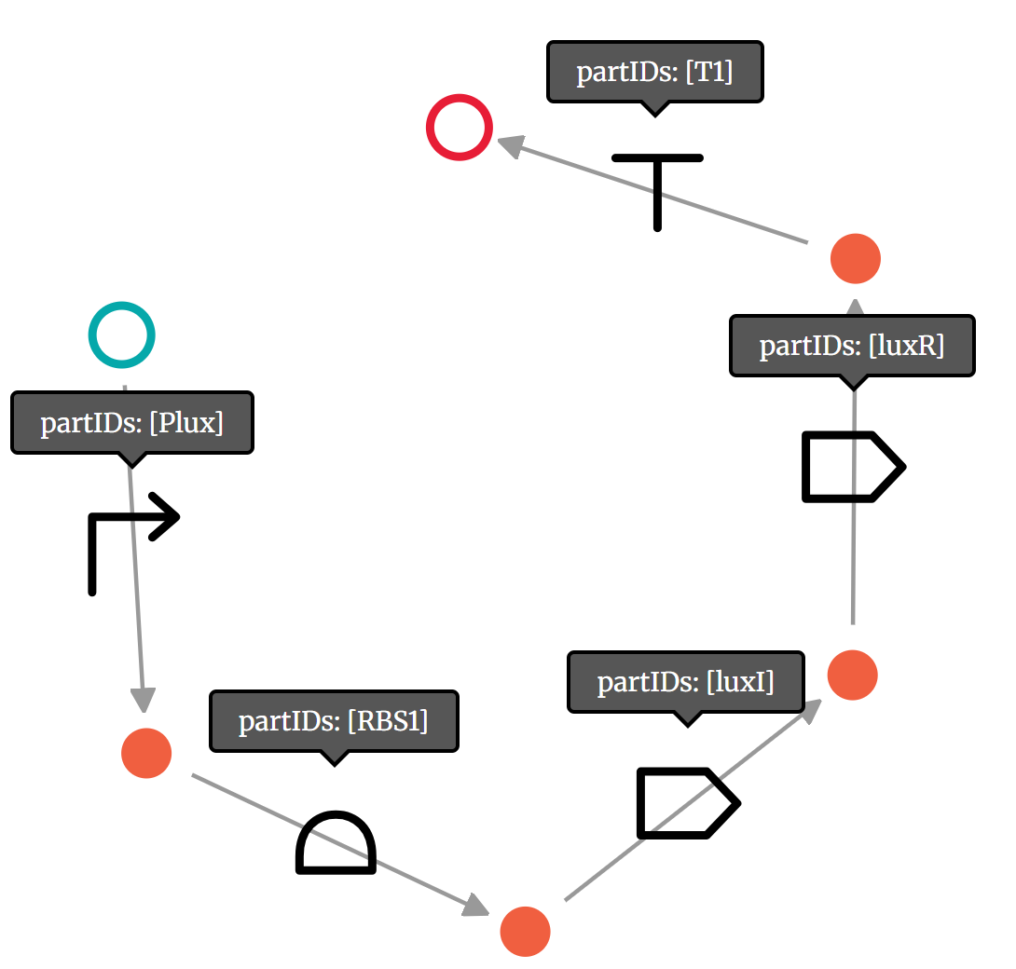
Short Specification: Knox Circuit Examples
Ecoli_K
Luxl_LuxR
Notes:
Nora

Slide 11
04
Detailed Functionality

Slide 12
Step 1) Create the Knox circuits
Step 2) Find the relevant ODEs from goldbar circuits (lit review)
Step 3) Run Claude to make xml file to run simulation in iBioSim
Detailed Workflow for Simulation Creation:
Notes:
WD

Slide 13
Detailed Functionality: Parameters
Cross-feeding — obligate amino acid mutualism
Kill switches — biosafety via toxin-antitoxin
Electroactivity — EET cytochrome current boost
Nitrification — ammonia to nitrate oxidation
Denitrification — nitrate to N₂ reduction
Production — valuable secondary metabolite biosynthesis
Quorum sensing — cell-density-dependent coordination

Slide 14
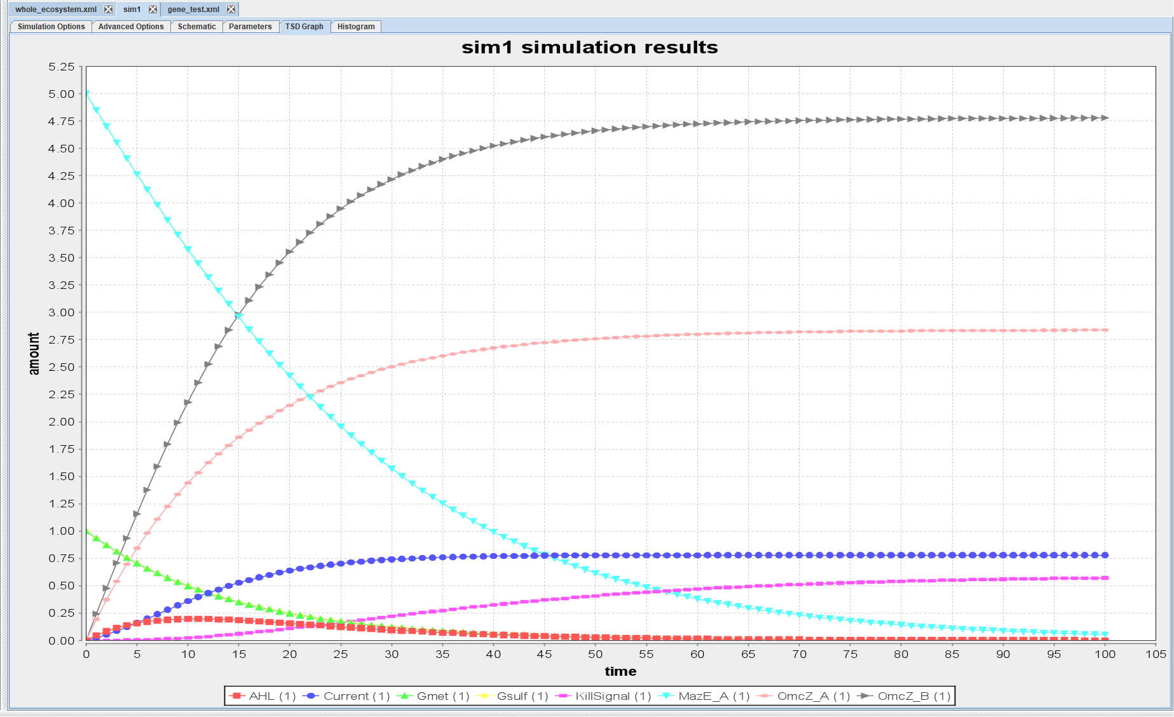
Detailed Functionality: iBioSim
Inserted equations into claude to generate SBML file
Uploaded directly to iBioSIM
Manually Verified
Notes:
WD

Slide 15
Detailed Functionality: iBioSim
Component Interplay
E. Coli Cross Feeding
Geobacter Electrogenic Co-culture
MazE/MazF Kill Switch
Quorum Sensing (LuxI/LuxR & LuxS)
Nitrogen Denitrification Cascade
Biosynthesis Pathways
How the Circuits Connect
Quorum Sensing → Kill Switch:
Gsulf population → AHL → LuxR_AHL → KillSignal → MazF → cell death
Nitrogen Cascade → Geobacter:
NO (from nirS step) → induces extra OmcZ_B → boosts Current output
E. coli → Biosynthesis:
E. coli strains maintain population stability, providing metabolic context for AcetylCoA-driven biosynthesis
Geobacter → Quorum Sensing:
Gsulf produces AHL (LuxI); Gmet produces AI2 (LuxS)
Both signals reflect Geobacter population density
Kill Switch → Geobacter:
When KillSignal threshold is reached, MazF accumulates and kills both Gsulf and Gmet
Reduces current output and OmcZ expression as a consequence

Slide 16
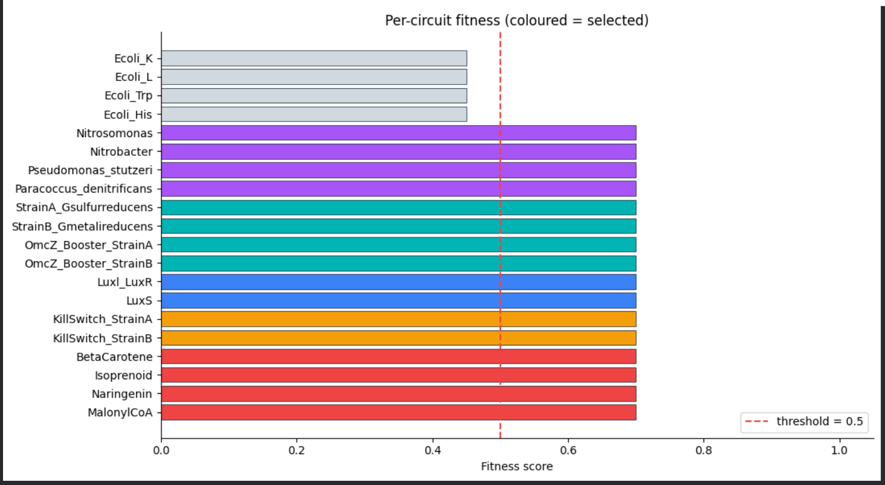
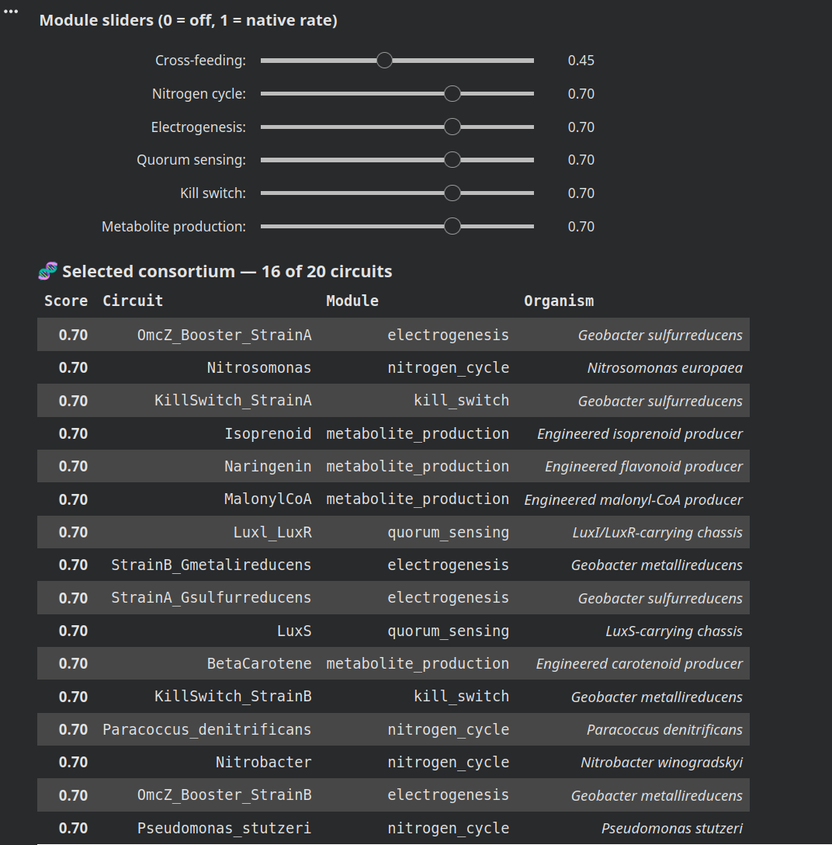
Detailed Functionality: User Application
Circuits library based on SBML file inputs
Genetic circuit reference table
“Species” defines concentrations for each condition
Sliders affect rates for each attribute
ODE and simulation
Selects Consortium
Notes:
WD

Slide 17
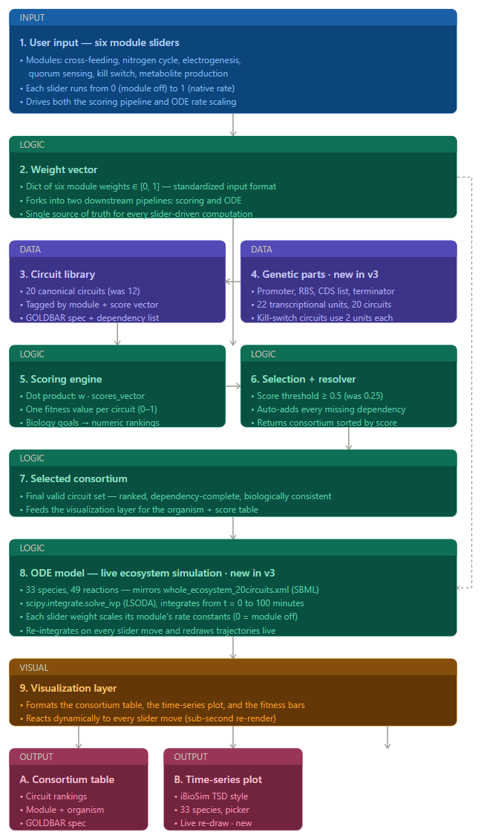
Detailed Functionality: Data Flow Diagram
Notes:
WD

Slide 18
05
Demo

Slide 19
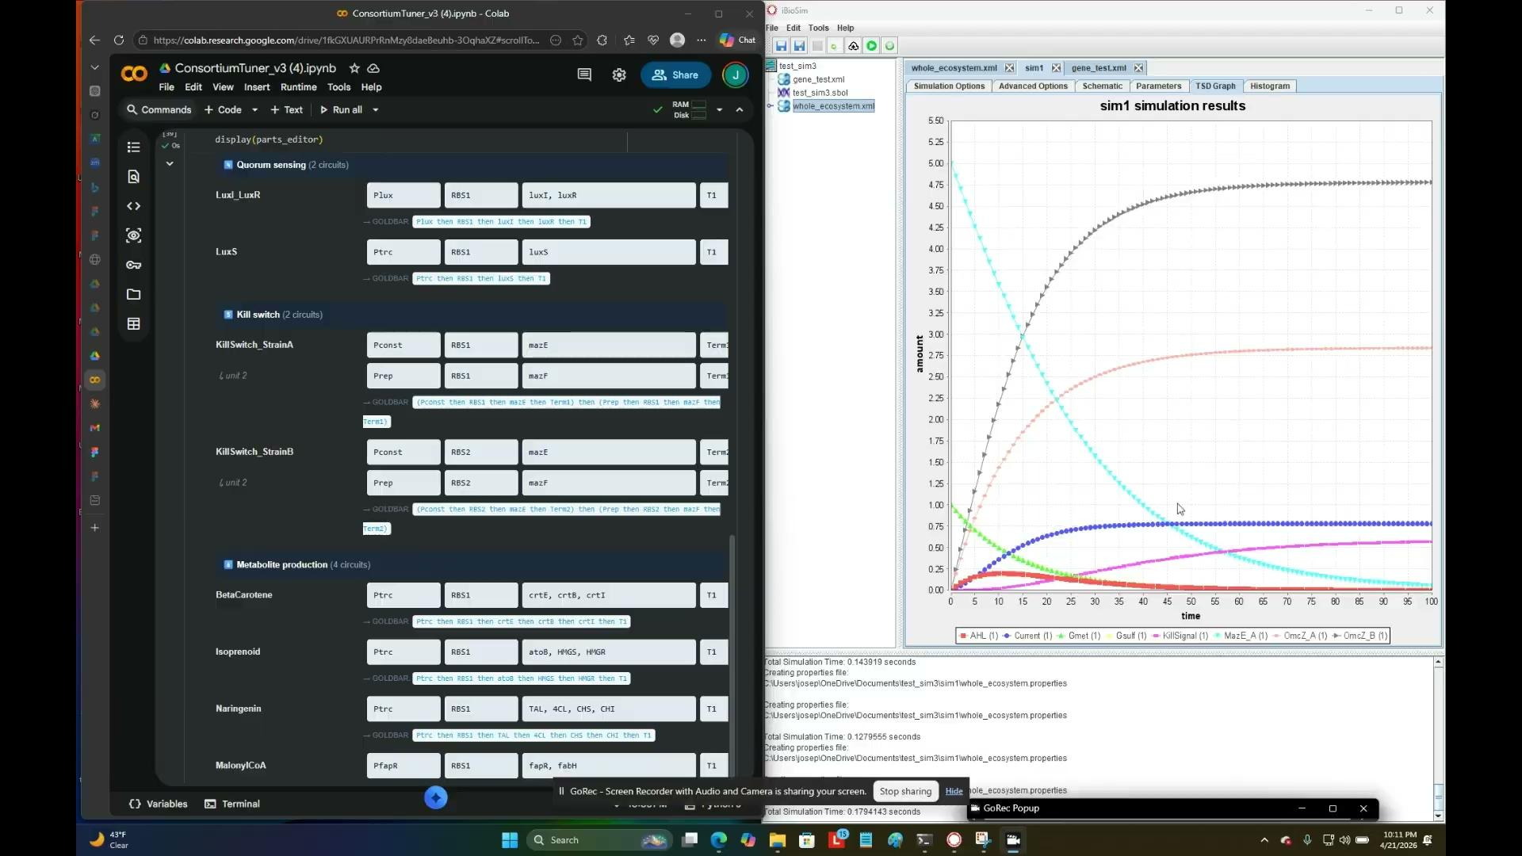
Demo Video

Slide 20
06
Successes & Failures

Slide 21
Analyses
What Went Right
What Went Wrong
Modular Design
Flexible framework allowed circuits to be freely combined across categories
Enabled rapid ecosystem assembly
Biological Grounding
Sludge circuits were drawn from validated literature, reflecting grounded data
Accessible Interface
GUI design made complex ecosystem approachable
Users can easily configure and simulate microbial communities
Relevant Literature
Plenty of relevant literature was found for our project, including relevant equations
Difficult to Address Complexity
Model connections are extremely diverse and difficult to keep track of
Difficult to Validate
Model assumptions may not hold in real world scenarios
No Standard MFC Models
A lack of existing standards makes industry adoption difficult
Oversimplified Models
Models did not capture full complexity
Data Limitations
Limited quantitative data reduced accuracy weakening the predictive reliability of outcomes
Notes:
WD

Slide 22
Design Tradeoffs
Biological Realism vs. Computational Simplicity
Simplified models kept simulation fast but sacrificed accuracy in metabolic dynamics
Modularity vs. System Stability
Free circuit combination boosted flexibility in circuits but made ecosystems prone to collapse
User Accessibility vs. Model Complexity
The GUI lowered the learning curve for Users but constrained parameter control
Literature-Based Selection vs. Design Flexibility
Grounding circuits in validated literature ensured biological relevance but narrowed circuit diversity

Slide 23
Potential Improvements
Scoring relies solely on design rules
experimental validation would strengthen predictive confidence
Simulations lack uncertainty quantification
adding stochastic modeling would capture biological variability
The circuit library is static
enabling user defined combinations would expand design space
Dependency rules are manually curated
Integrating automated inference would improve scalability
Slider outputs are deterministic
incorporating sensitivity ranges would better reflect real system dynamics
Expanding circuit categories would increase the platform's biological coverage
Notes:
WD

Slide 24
Who Worked on What
Literature Review: Jaleel
Knox Circuits: Nora & Jon
Simulations: Nora, Jon, Jaleel, William
GUI interface: Nora, Jon, Jaleel, William
Notes:
WD

Slide 25
Thanks!
GitHub:
millerjd-netizen/Microbial_Cell_Ecosystem: Microbial Cell Ecosystem: a terminal-first E. coli + Geobacter co-culture design recommender with KNOX-inspired circuit selection, Tellurium verification, uncertainty-aware scoring, and optional calibration support

